Slide 1

PREDICTING COMPRESSIVE STRENGTH OF CONCRETE USING IBM WATSON MACHINE LEARNING
TEAM MEMBERS:
SIMRAN RAJPAL – 18BEI0123
RISHIKA – 18BEI0119
KSHITIJ DUBEY – 18BEI0128
PRAGYA JAIN – 18BEE0253

Slide 2
INTRODUCTION
The Compressive Strength of Concrete determines the quality of Concrete. This is generally determined by a standard crushing test on a concrete cylinder. This requires engineers to build small concrete cylinders with different combinations of raw materials and test these cylinders for strength variations with a change in each raw material. The recommended wait time for testing the cylinder is 28 days to ensure correct results. This consumes a lot of time and requires a lot of labour to prepare different prototypes and test them. Also, this method is prone to human error and one small mistake can cause the wait time to drastically increase.
One way of reducing the wait time and reducing the number of combinations to try is to make use of digital simulations, where we can provide information to the computer about what we know and the computer tries different combinations to predict the compressive strength. This parameter is usually determined through expensive laboratory tests, causing a loss of resources, materials and time. However, artificial intelligence and its numerous applications are examples of new technologies that have been used successfully in scientific applications.

Slide 3
OBJECTIVE
To classify if it is a regression or a classification kind of problem.
To pre-process/clean the data using different data pre-processing techniques.
Applying different algorithms according to the dataset
To find the accuracy of the model.
To build web applications using the Flask framework.

Slide 4
PROJECT FLOW
● Data Collection.
○ Collect the dataset or Create the dataset
● Data Pre- processing.
○ Import the Libraries.
○ Reading the dataset.
○ Processing of the data
○ Taking care of Missing Data.
○ Label Encoding ○ Data Visualization.
○ Splitting the Dataset into Dependent and Independent variables.
○ Splitting Data into Train and Test.
● Model Building
○ Training and testing the model ○ Evaluation of Model
● Application Building
○ Create an HTML file
○ Build a Python Code

Slide 5
PROPOSED SOLUTION
A mathematical model for prediction of compressive strength of concrete will be performed using statistical analysis for the concrete data obtained from experimental work done in this study. The multilinear regression yielded excellent correlation coefficient for prediction of compressive strength at different ages (3, 7, 14, 28, 91 days). The coefficient of correlation was 99.99% for each strength (at each age).
Also, the model gives high correlation for strength prediction of concrete with different types of curing. Given the characteristics of the concrete production process, multi linear regression is considered a very suitable modelling algorithm, due to its versatile merits, such as its good tolerance for outliers and noises, its ability to avoid overfitting, and its ability to deal with multicollinearity.

Slide 6
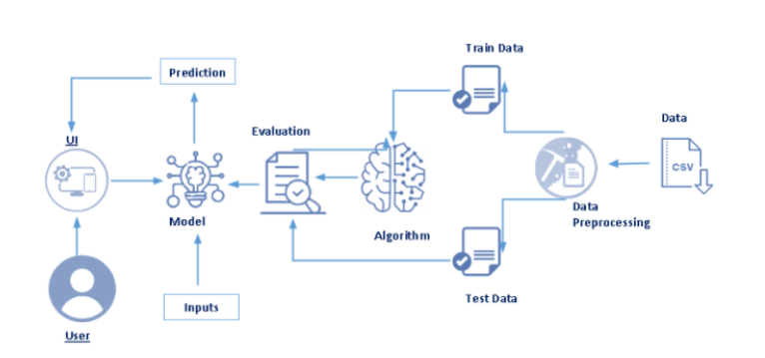
BLOCK DIAGRAM

Slide 7
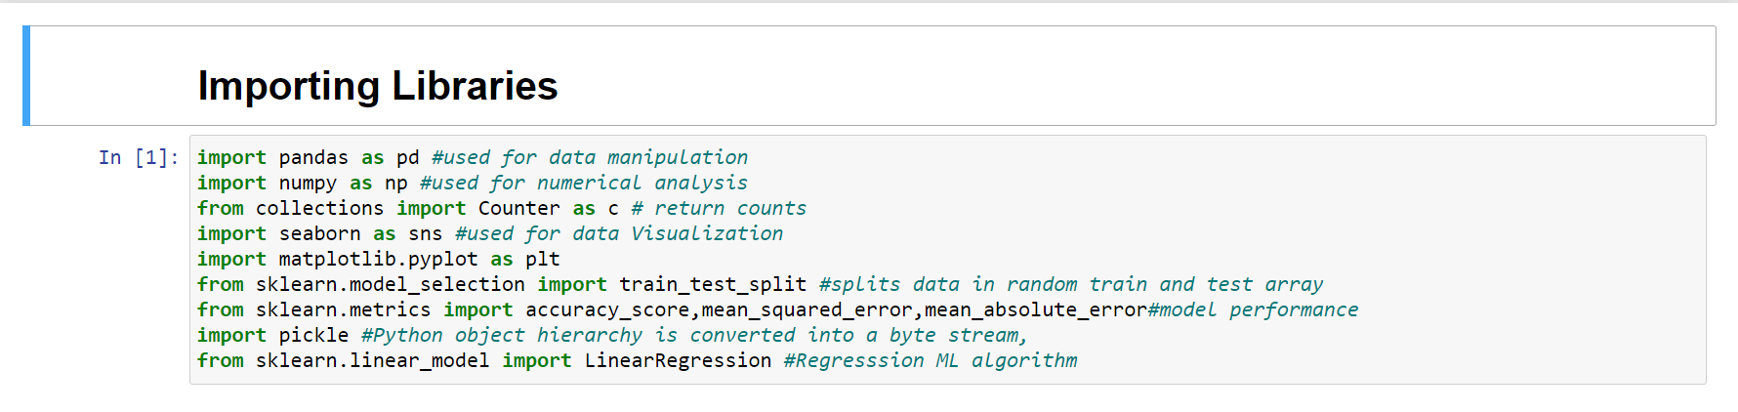
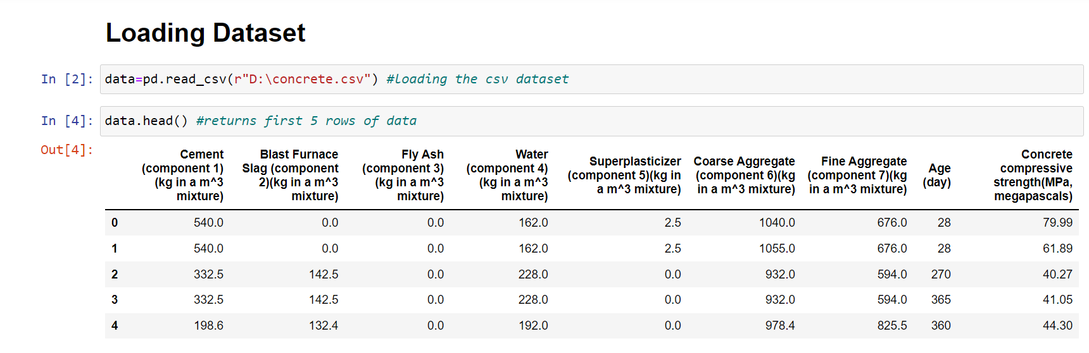
DATA PREPROCESSING

Slide 8
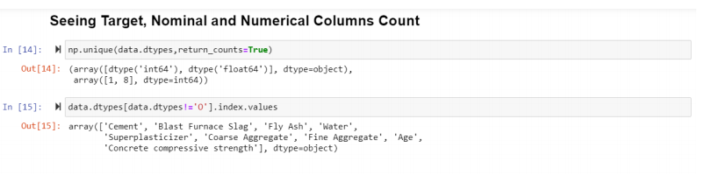
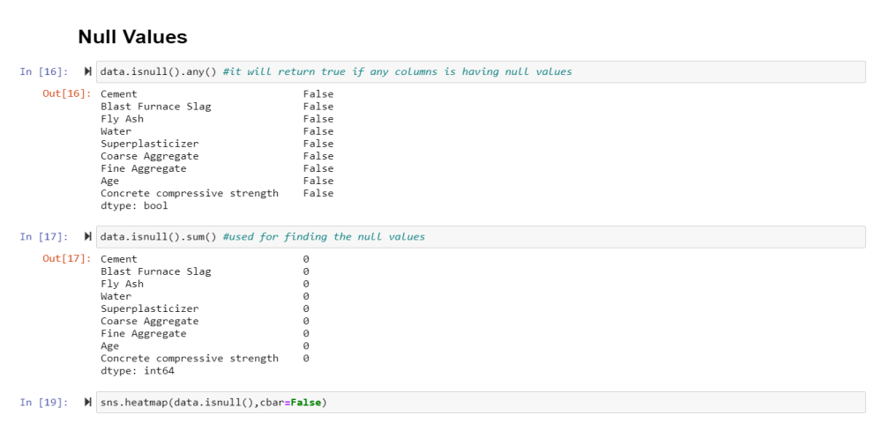
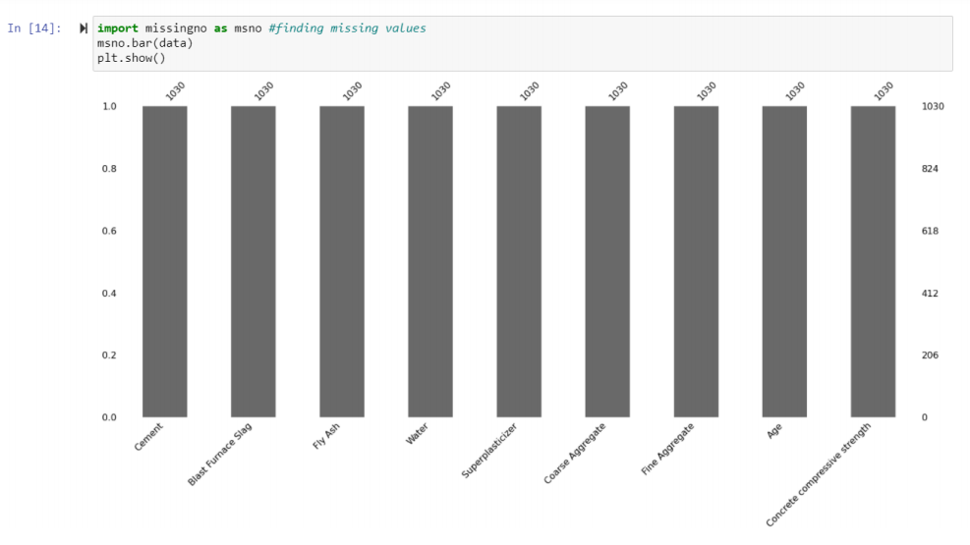

Slide 9
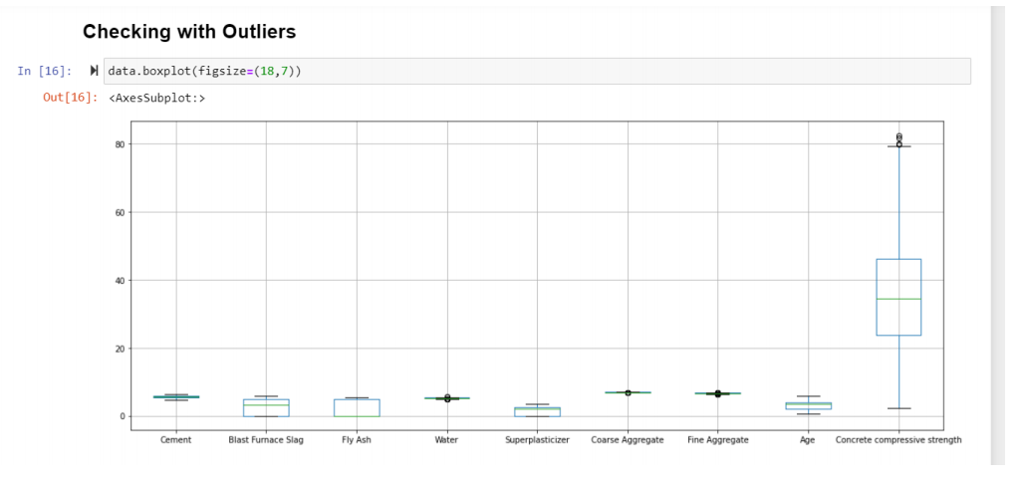
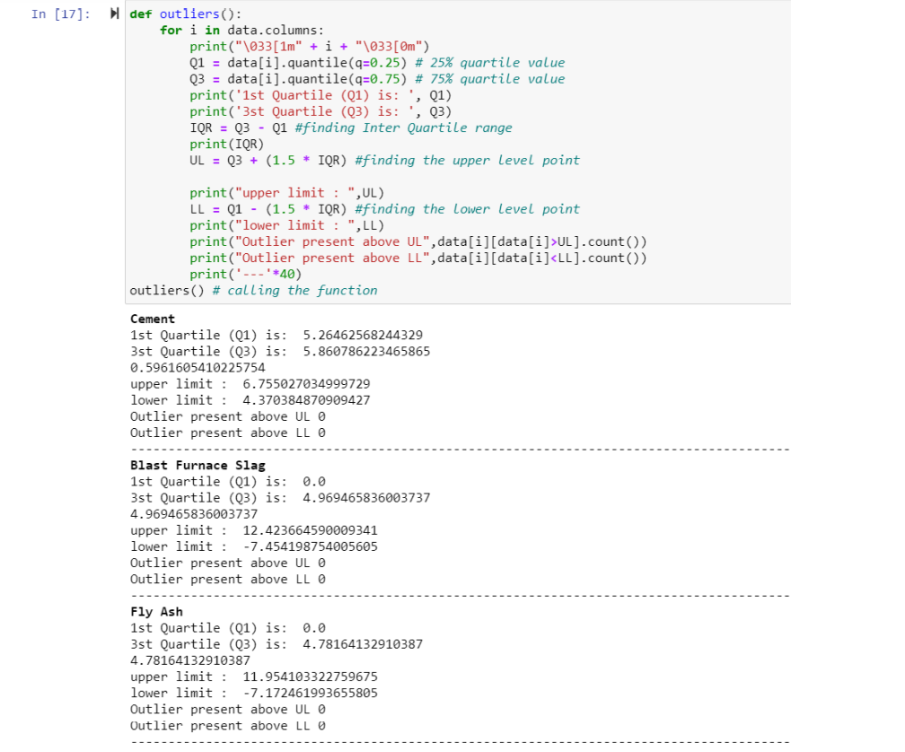
DATA VISUALISATION

Slide 10
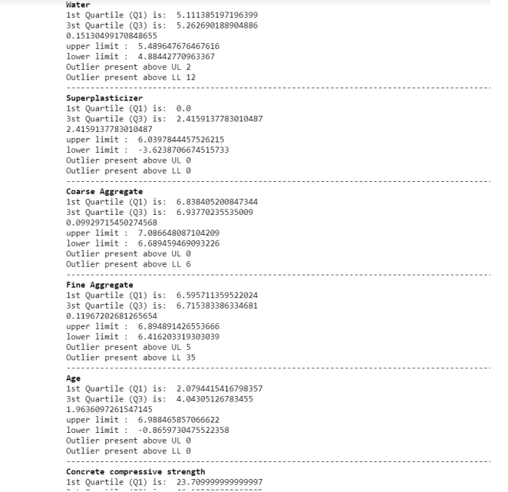
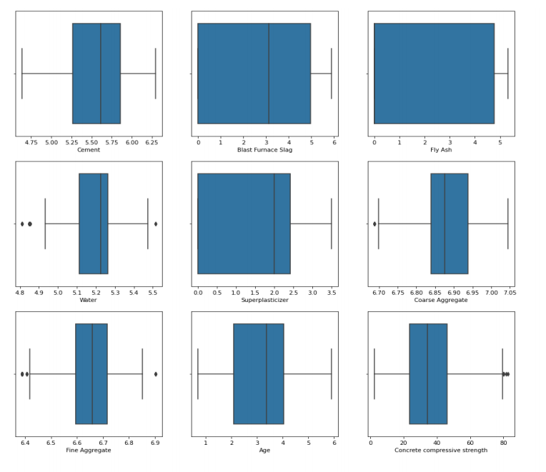

Slide 11
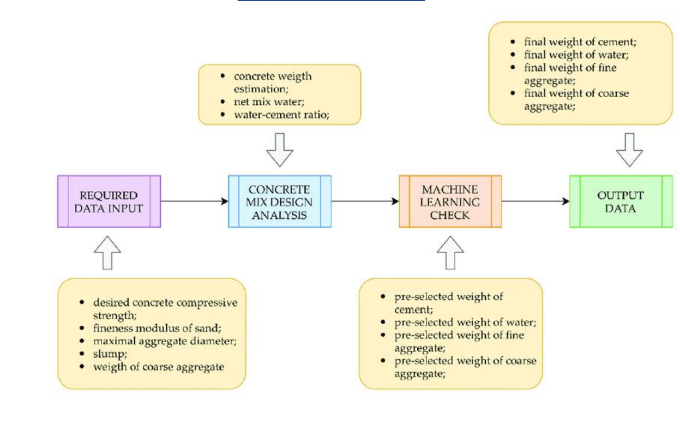
FLOWCHART

Slide 12
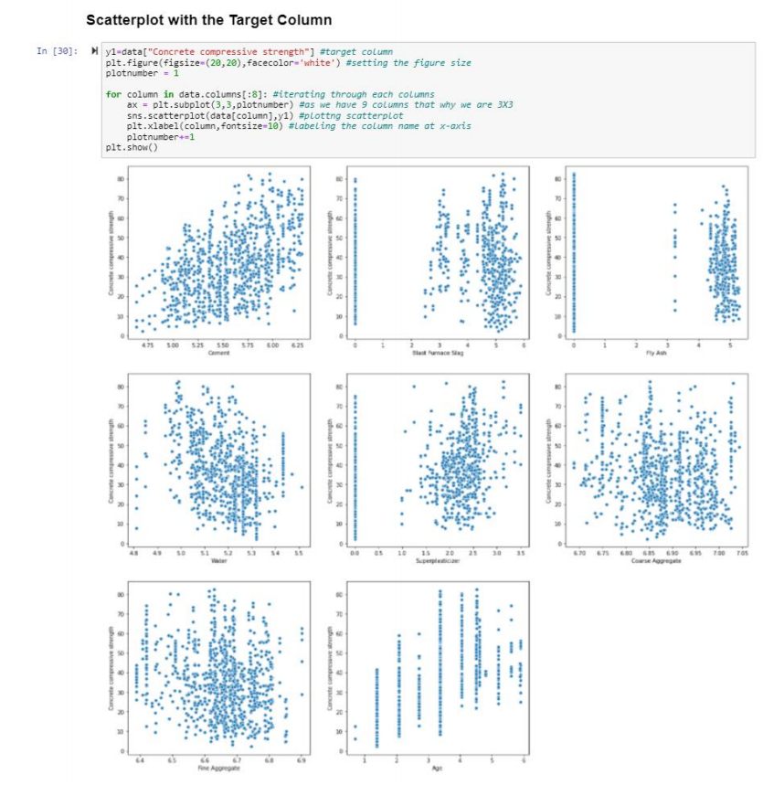
EDA- ANACONDA (JUPYTER)

Slide 13
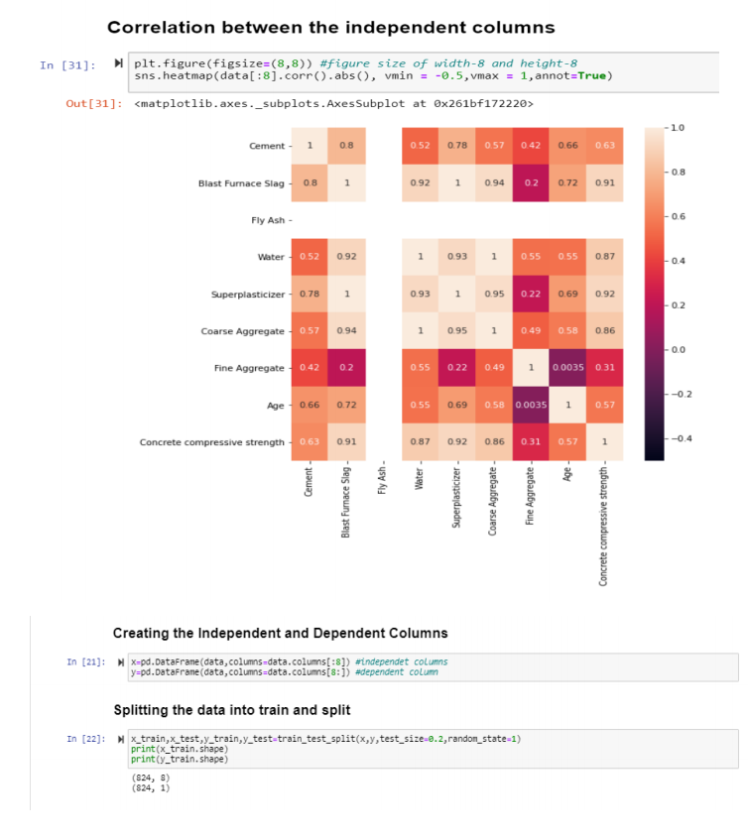
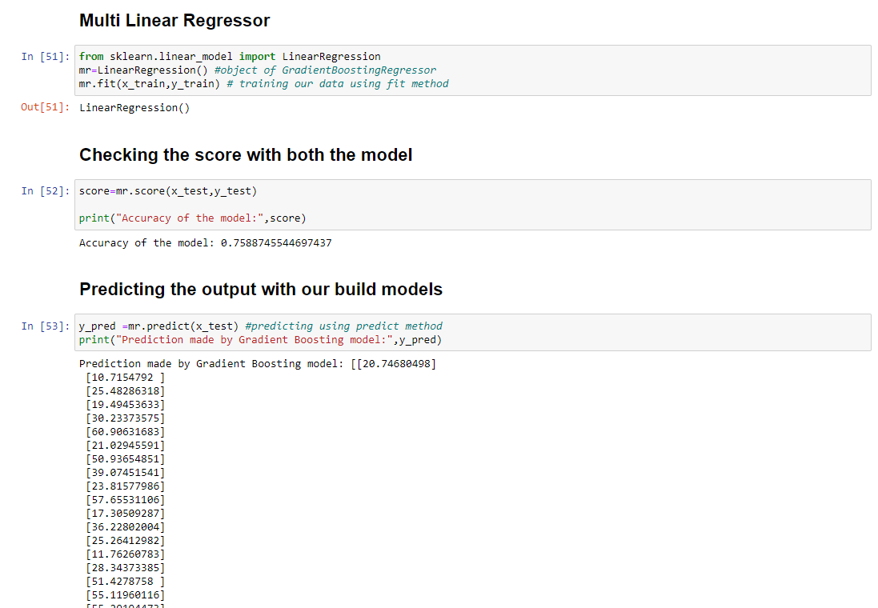
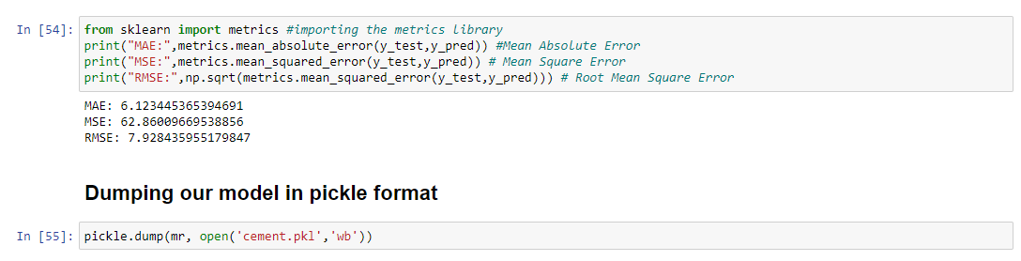

Slide 14

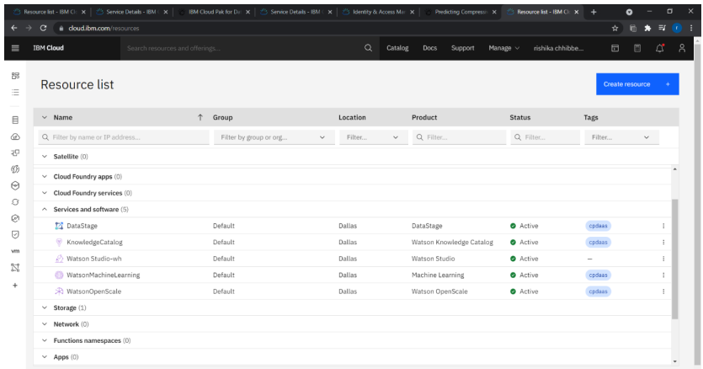
IBM WATSON STUDION

Slide 15
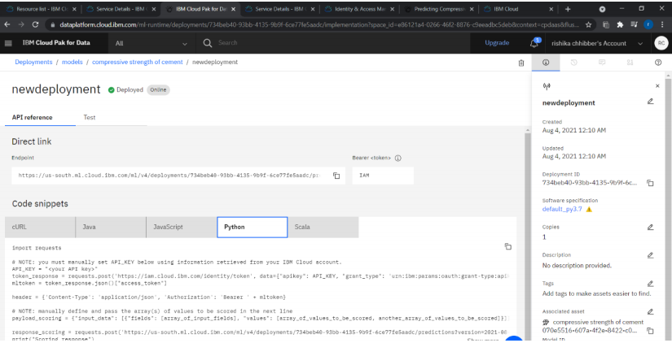
IBM WATSON STUDION

Slide 16
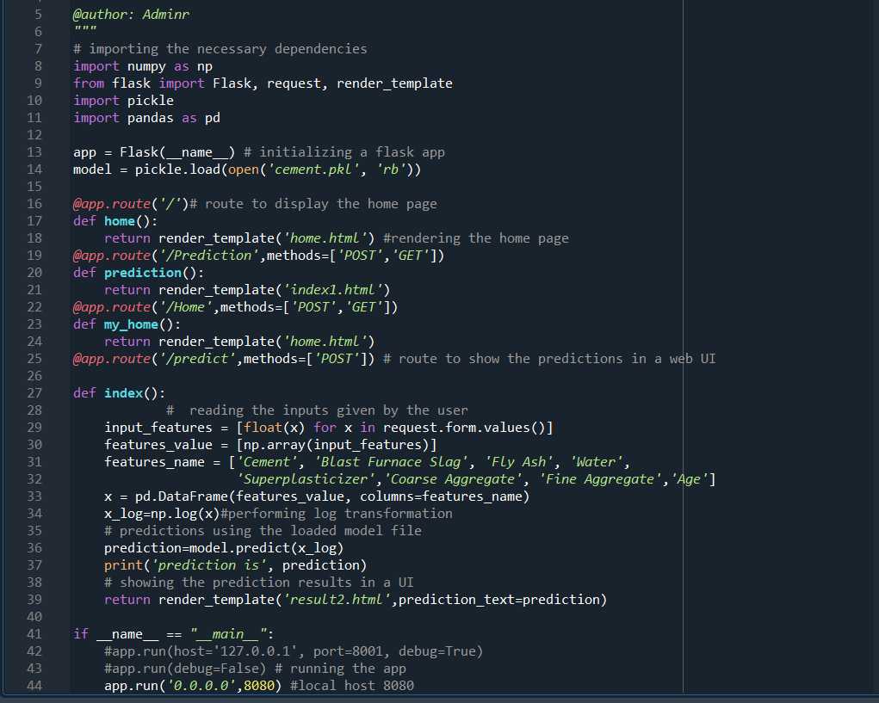
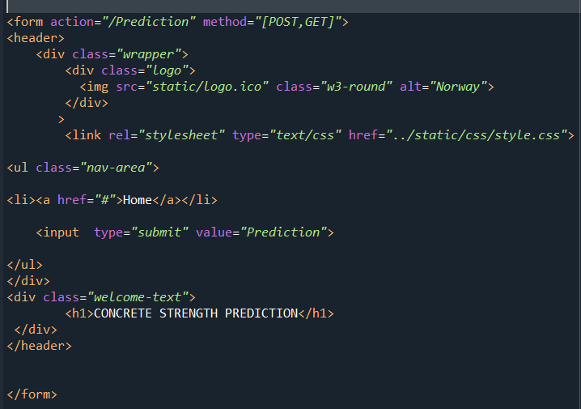
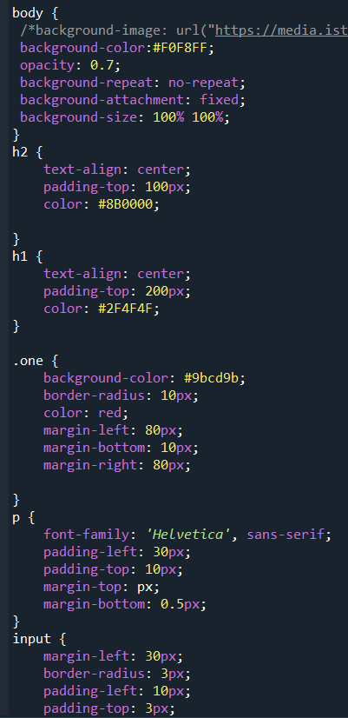
APPLICATION BUILDING
Importing the libraries & Routing The HTML Pages
SAMPLE HTML CODE
SAMPLE CSS CODE

Slide 17

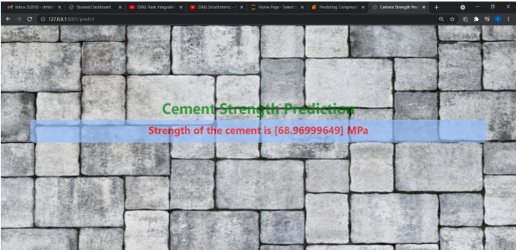
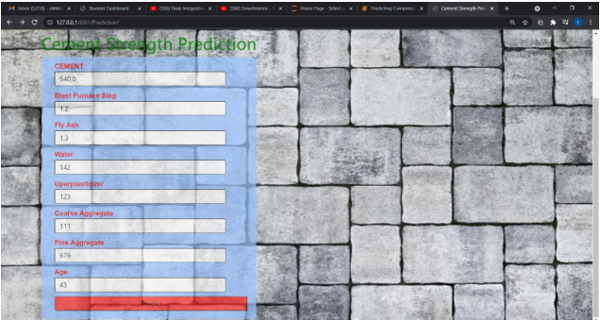
UI OUTPUT SCREENSHOTS

Slide 18
FUTURE SCOPE
For now, we have created the web application of the process, which can be further converted to an android app which will be more useful and convenient for the user to use and will help in saving time. App development will help in creating the project process oriented.

Slide 19
CONCLUSION
Earlier and accurate estimation of concrete strength are valuable to the construction industry. The presence of such model would possibly obtain the hard balance and equality between controlling the quality (quality control process) and economics (saving time and expense, i.e., this model could be used in construction to make the necessary adjustments on mix proportion used, to avoid situations where, concrete does not reach the required design strength or by avoiding concrete that is unnecessarily strong.
This methodology allows a fast and accurate prediction of values for compressive strength on site. Common methods for estimation of in place strength requires extensive use of curing of mortar cubes at constant temperatures or the use of databases containing a large number of compressive strength values made at many ages and cured at different temperatures. These databases have to be fed with a statistical relevant amount of data before a reliable estimation of the strength can be made.
Furthermore, all of these methods requires many hours of lab and field time for testing, collecting and analysing data. Furthermore, the existing variables in the model yielded good reasonable results. Also, it is not preferred to load the prediction model with large number of variables, because it is preferred to use a model with lesser number of variables with higher possible accuracy to assure the rapid and easy use of the model.

